Slide 1


Covid 19 Spread Analysis
DSC630 Milestone 4
Carla Harrell

Slide 2
Project Goal
Different parts of the country are experiencing different level of activity of this virus. At the very beginning, the testing was problematic due to shortage of supplies and lack of testing facilities. In the United States, they have partnered with private hospital laboratories to revamp testing. More people are beginning to test positive and the numbers are increasing. In the meantime, most states have mandated that only essential employees to go to work and closed all non-essential businesses.
This process is still a learning curve for everyone. As time progress more information will be discovered and distributed. Most of the measures are geared toward flattening the curve. In my approach, I will attempt to use the best available dataset to predict the spread factor to see the effectiveness of measures taken to flatten the curve.

Slide 3
Data Sources
Since, corona analysis is a new topic, gathering relevant data for analysis is a challenge. For this purpose, I integrated multiple reliable sources which target different aspects of this spread.
Population_by_country_2020.csv
https://www.kaggle.com/tanuprabhu/population-by-country-2020
states_code.csv
https://aruljohn.com/usstates/
us_states_median_.csv
https://worldpopulationreview.com/states/median-age-by-state/
us_states_population_.csv
https://www.worldometers.info/world-population/us-population/
us_covid19_daily.csv
https://www.kaggle.com/sudalairajkumar/covid19-in-usa
us_states_covid19_daily.csv
https://www.kaggle.com/sudalairajkumar/covid19-in-usa
https://github.com/CSSEGISandData/COVID-19/tree/master/csse_covid_19_data/csse_covid_19_time_series

Slide 4

Data Preprocessing and Aggregation
Analyze different aspects of the spread like – spread factor, state-wise analysis in US, population and age analysis over the spread etc. For this, a few datasets were merged, and preprocessed to create data frames ready for evaluation and analysis.
Perform the following operations on the data to make it a rich source of insights:
Merging and joining of datasets for population, median age and population density of each states in the US with confirmed and death cases due to Corona.
Imputing missing values in each dataset either by taking average method or removing null rows.
Calculation of new columns like Spread Factor and Days since Outbreak.
Data type conversion for columns like dates and timestamps for easy calculation.

Slide 5
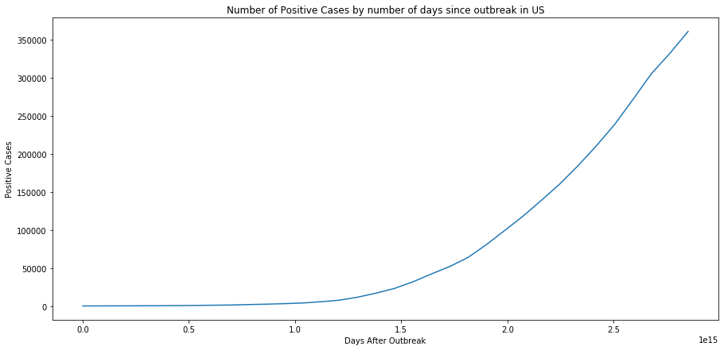
Exploratory Data Analysis
Since the day of outbreak in US, virus has infected people on an exponential level as can be seen from the above graph.
This is an important curve as later we focus on how flattening will decrease the number of positive cases on a daily basis.

Slide 6
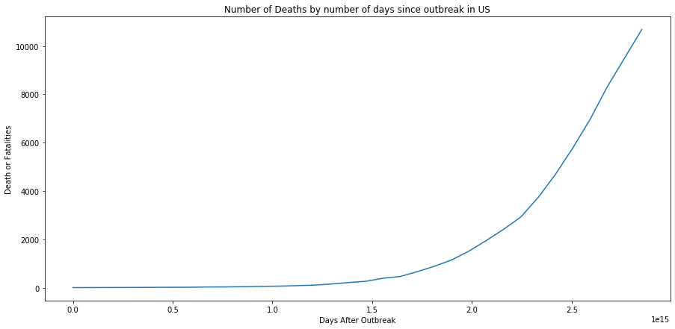
As positive cases increased, the deaths due to the infection increased too proportionally in the US as can be seen from the above graph. We could conclude that deaths are directly proportional to increased positive cases and the only way to decrease death increase is by putting a slow down on new positive cases every day.

Slide 7
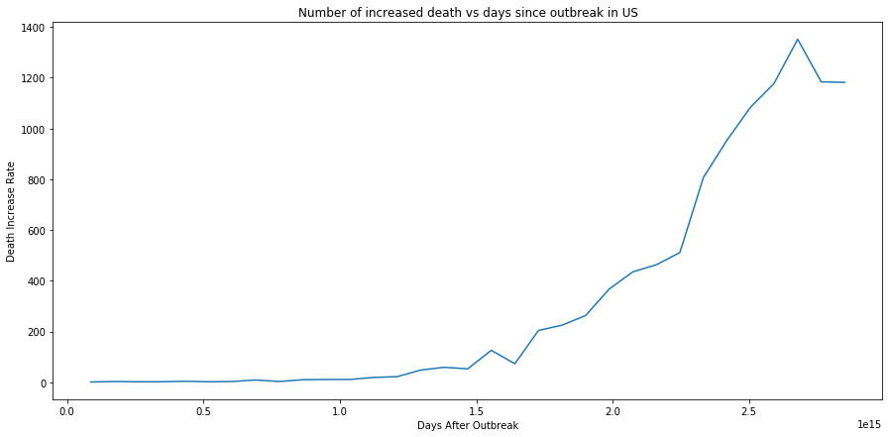
There is an increase in daily increased deaths every day. However, after reaching the maximum, there is a decrease in increased death every day. This is because as more and more testing was performed in US, more people were tested and treated immediately decreasing the deaths gradually.

Slide 8
Spread Factor
Death Increase rate does not give us a proper indication of the spread of this outbreak as death depends on individual's immune system and many other factors. To understand the spread of outbreak we need to calculate the growth factor or spread factor of Covid-19 in United States.
We can calculate the Spread Factor based on positive cases Increase each day compared to previous day.
Spread Factor for present day = Positive Increase for present day/ Positive increase for previous day
Note: Spread factor for first two days will be zero as it depends on the previous day

Slide 9
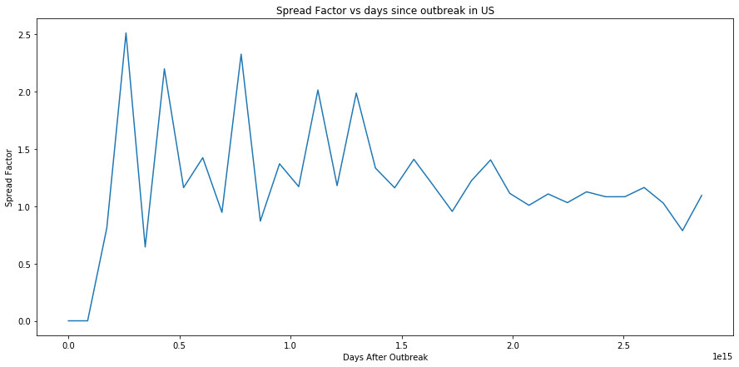
The Spread Factor spiked initially but gradually had a flattening effect as people and agencies became aware of the situation and effective measures were taken to control the spread.

Slide 10
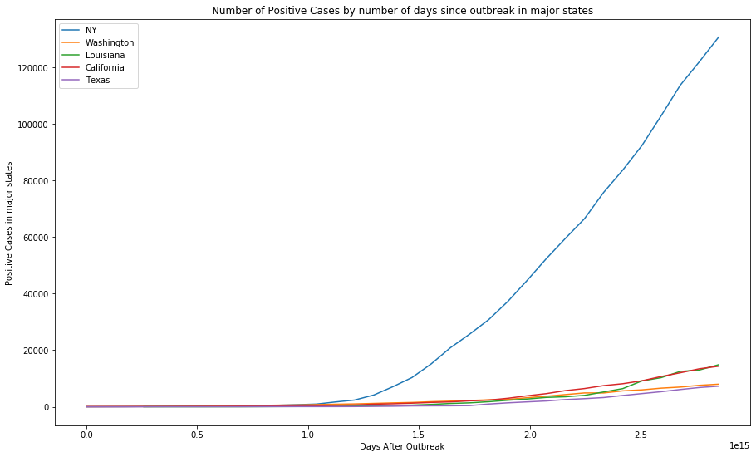
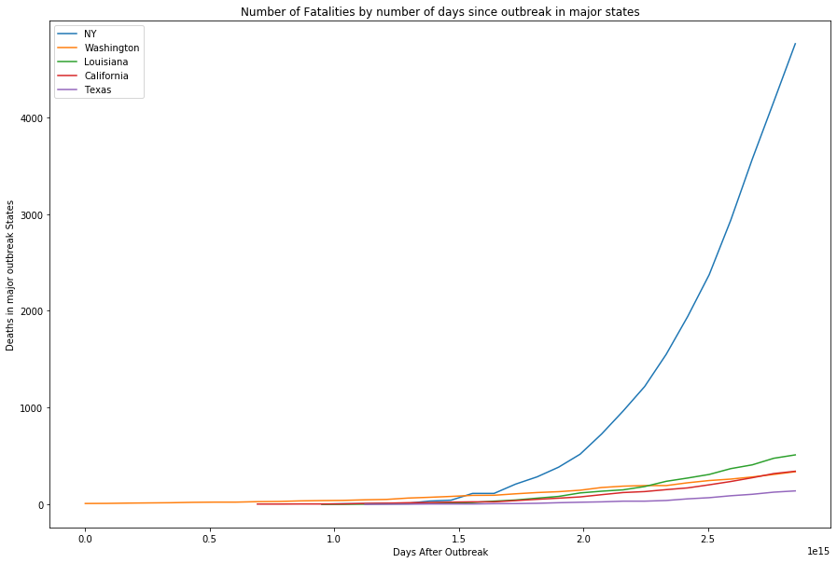
Even in US, there are variations in the spread across each state based on population density and other factors like airports, travel factors, and others. So, a state-wise analysis for major states with high spread of this virus was performed. New York has the worst hit of all with highest number of positive cases and fatalities. For this reason, the first model of polynomial regression is based on cases in New York State.

Slide 11
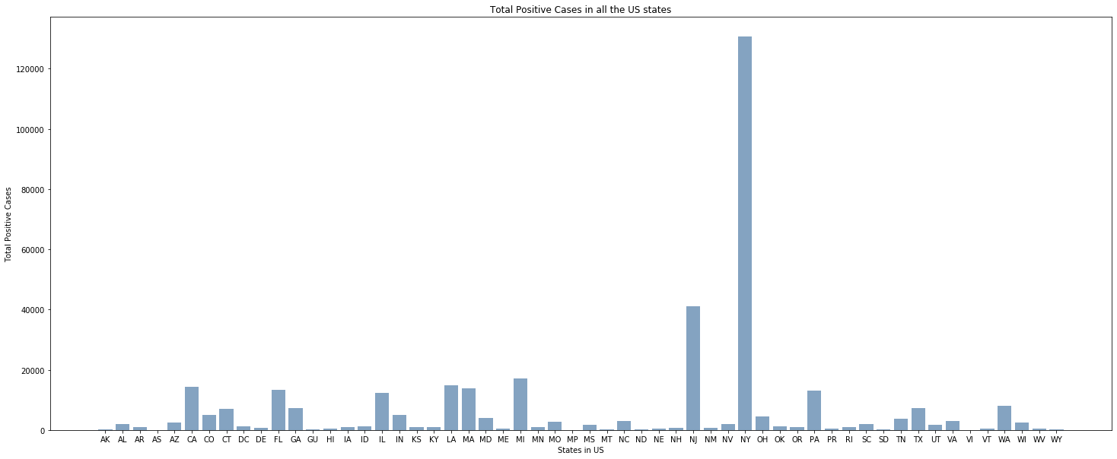
This gives an overall condition of all the states in the US, and there is a drastic difference in the total positive cases across the states.

Slide 12
Models Built
Spread Factor Prediction using Polynomial regression- This model produce the prediction for spread factor for next 5 days for New York city.
Linear Regression Model predicting total cases in each states based on population, median age and population density of that region.

Slide 13
Model 1- Polynomial Regression Model
Model 1 predict future days spread for New York State based on positive Increase and Spread Factor.
Model 1 gives the user the ability to change the degree of the regression to enable polynomial models. It is tested on degree 2, 3, and 4.

Slide 14
Model 1 Algorithm
Model 1 is a Polynomial Regression model used the following algorithm steps:
Selected the entire data for NY state
Calculate the spread factor for NY
Handle the missing values and NANs in NY data
Import Polynomial Regression and related libraries in Python
Create a regression model based on Spread Factor and Confirmed Cases along with days since outbreak factor.
Based on user input for degrees, the model can be transformed from linear regression to polynomial regression
User input decides the number of future days for which the prediction must be made.

Slide 15
Model 1 – Results and Performance
Regression Degrees: 2
Future days Spread_factor Pred_positiveIncrease Pred_Confirmed
0 0.820594 7104 137793
1 0.774053 5498 143291
2 0.725973 3991 147282
3 0.676354 2699 149981
4 0.625196 1687 151668
The spread factor and estimated predicted positive are declining with an increase in confirmed cases for future 5 days.

Slide 16
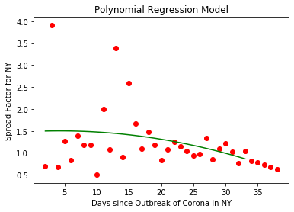
Fitting and Evaluation of Model 1 at 2 Degrees
After fitting the model and testing it for next 5 future days, the curve is going down for future days based on the Spread factor and increase in the positive cases for New York. Through this model, the spread factor can be predicted. Therefore the potential increase in positive cases for future days can also be predicted.

Slide 17
Model 1 – Results and Performance
Regression Degrees: 3
Spread_factor Pred_positiveIncrease Pred_Confirmed
0 0.901578 7805 138494
1 0.884485 6903 145397
2 0.870184 6006 151403
3 0.858923 5158 156561
4 0.850947 4389 160950
The spread factor and estimated predicted positive is declining with an increase in confirmed cases for future 5 days.

Slide 18
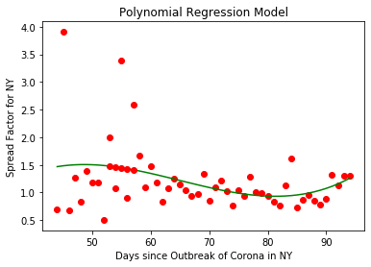
Fitting and Evaluation of Model 1 at 3 Degrees Degrees

Slide 19
Model 1 – Results and Performance
Regression Degrees: 4
Spread_factor Pred_positiveIncrease Pred_Confirmed
0 1.379318 11942 142631
1 1.651766 19725 162356
2 2.003647 39521 201877
3 2.445430 96645 298522
4 2.988148 288789 587311
The spread factor, estimated predicted positive, and confirmed shows an increase in cases for future 5 days.

Slide 20

Fitting and Evaluation of Model 1 at 4 Degrees Degree

Slide 21
Model Validation
RMSE Increases As You Move To Different Degrees
2 Degrees
Root Mean Squared Value = 0.3638
Mean Absolute Percentage Error= 32.45%
Accuracy = 67.55%
3 Degrees
Root Mean Squared Value = 0.6328
Mean Absolute Percentage Error= 59.61%
Accuracy = 67.55%
4 Degree
Root Mean Squared Value = 0.3725
Mean Absolute Percentage Error= 31.01%
Accuracy = 68.99%

Slide 22

Best Model at 2 Degrees
The idea is to remove last 5 day's spread factor value from the training dataset and allow the model to learn without the last 5 day's values. Then, the model is used to produce predictions of the 5 days that were removed from the dataset. The predications is compared to what had happened in actual by calculating different error metrics like calculate the root mean squared error and mean absolute percentage error(MAPE). Ideally, a MAPE of <35-40% would categorize the model as a good predictive model.
Root Mean Squared Value = 0.3638
Mean Absolute Percentage Error = 32.45 %
Accuracy = 67.35%
The model tested at 2 degrees gives a MAPE of 32.45% which is a good number as expected. However, this would get better as more data is added and is used in the model which is the beauty of machine learning model. The models get better with more data.
The Spread Factor declined in future for NY based on our polynomial regression output.

Slide 23
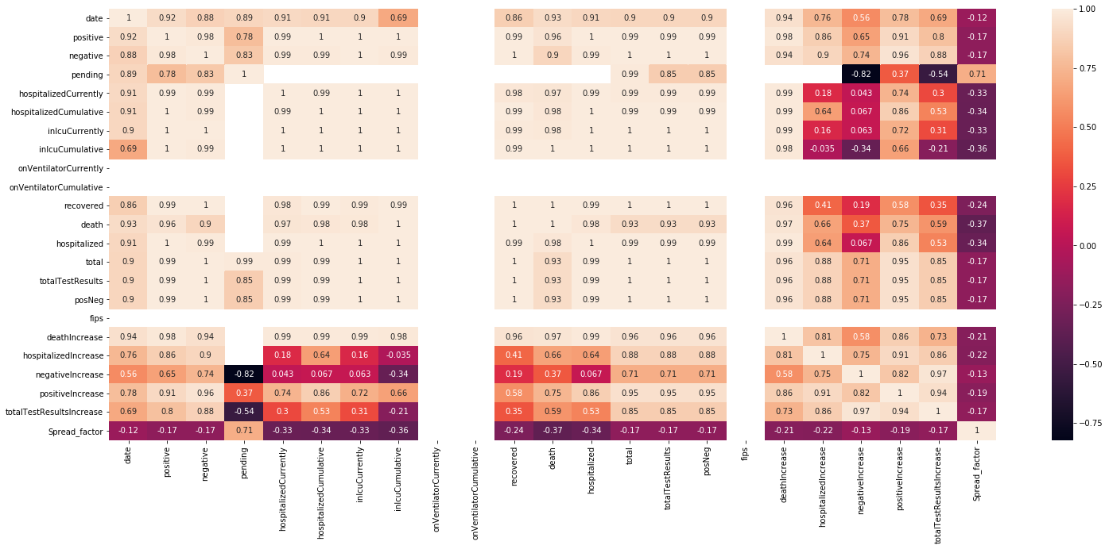
Correlation Plot
Before looking at the model 2, a correlation matrix is used to analyze the data to see the relations between different attributes.
Below is the correlation matrix of the New York Data:

Slide 24
Model 2- Linear Regression
A hypothesis test was attempted using linear regression to predict positive cases based on population and population density, median age in states.
This will not give a real picture. The prediction as spread is not only based on age and population, but many other non-quantified factors.

Slide 25
Explanation of Model 2
The Model 2 is kind of a hypothesis testing to verify whether population and median age of a region/state or province matters in the spread of this virus.
As per the results of this regression analysis, it doesn’t matter to a significant extent.
The world’s stats for countries, their population, median age and number of positive cases were collected and used this to train a linear regression model.
Similar stats for states in US were also collected to use them as my validation data.

Slide 26
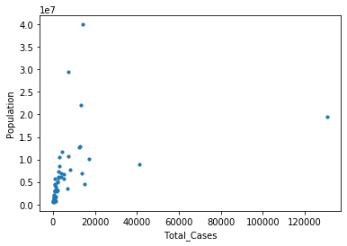
Model 2 - Results
Mean Absolute Error – 12817
MSE – Mean Squared Error - 1362885423
Population is slightly correlated to total cases. However, this virus spreads irrespective of the population density and median age of the region. It is now in community spread phase and therefore, these factors are not able to quantify the spread or growth. This was the whole purpose of Model 2.

Slide 27
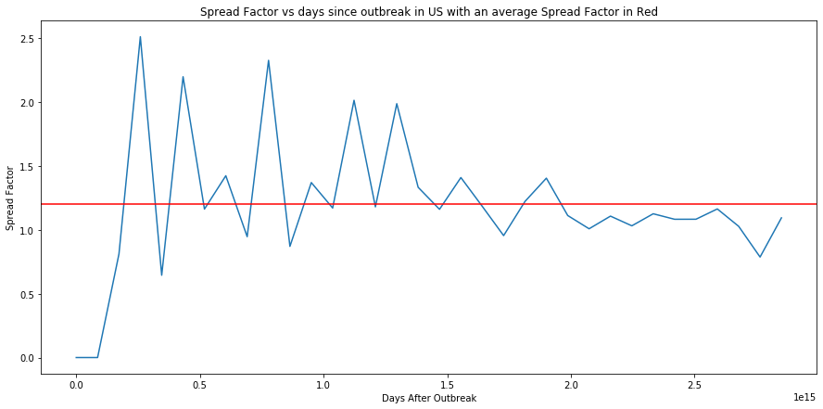
Summary and Conclusion
The spread factor graph shows the spread spike initially. After more testing and isolation, it shows a gradual decrease with less spikes. Future days were added to Model 1 to predict the spread and future cases using polynomial regression.
Using Model 1 prediction, it successfully demonstrated the spread will be flattening in future days as can see currently.
Using Model 2, The hypothesis test can be strengthened with the number of positive cases in a region does not solely depend on the population density and the demographic factors like age. There are several other factors involved in increasing the spread in a country or province.

